Slide 1

LECTURE 5: Use Cases
Instructor: Maria Striki
Presentation: Ivan Marsic, Maria Striki
Rutgers University

Slide 2
Topics
Agile Development Techniques
Actors, Goals
Sketchy/Summary Use Cases
Use Case Diagram
Traceability Matrix
System Boundary and Subsystems
Detailed Use Case Specification
System Sequence Diagrams
Security and Risk Management

Slide 3
Agile Development Techniques

Slide 4
Extreme programming
A very influential agile method, developed in the late 1990s, that introduced a range of agile development techniques.
Extreme Programming (XP) takes an ‘extreme’ approach to iterative development.
  New versions may be built several times per day;
  Increments are delivered to customers every 2 weeks;
  All tests must be run for every build and the build is only accepted if tests run successfully.

Slide 5
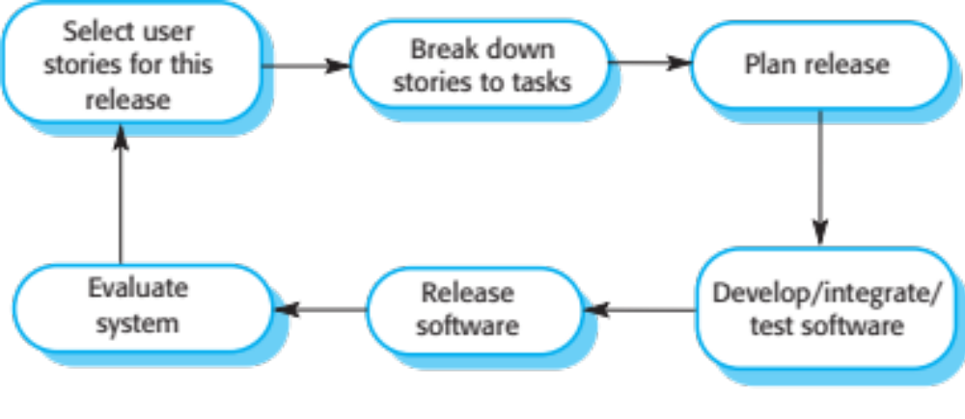
The extreme programming release cycle

Slide 6
Extreme programming practices (a)
Principle or practice | Description
Incremental planning | Requirements are recorded on story cards and the stories to be included in a release are determined by the time available and their relative priority. The developers break these stories into development ‘Tasks’. See Figures 3.5 and 3.6.
Small releases | The minimal useful set of functionality that provides business value is developed first. Releases of the system are frequent and incrementally add functionality to the first release.
Simple design | Enough design is carried out to meet the current requirements and no more.
Test-first development | An automated unit test framework is used to write tests for a new piece of functionality before that functionality itself is implemented.
Refactoring | All developers are expected to refactor the code continuously as soon as possible code improvements are found. This keeps the code simple and maintainable.

Slide 7
Influential XP practices
Extreme programming has a technical focus and is not easy to integrate with management practice in most organizations.
Consequently, while agile development uses practices from XP, the method as originally defined is not widely used.
Key practices
  User stories for specification
  Refactoring
  Test-first development
  Pair programming

Slide 8
User stories for requirements
In XP, a customer or user is part of the XP team and is responsible for making decisions on requirements.
User requirements are expressed as user stories or scenarios.
These are written on cards and the development team break them down into implementation tasks. These tasks are the basis of schedule and cost estimates.
The customer chooses the stories for inclusion in the next release based on their priorities and the schedule estimates.

Slide 9
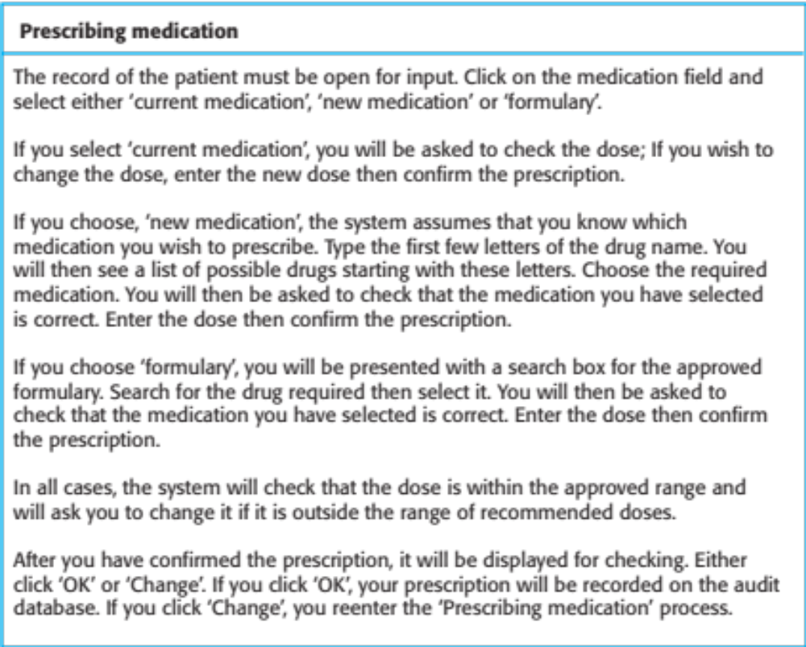
A ‘prescribing medication’ story

Slide 10
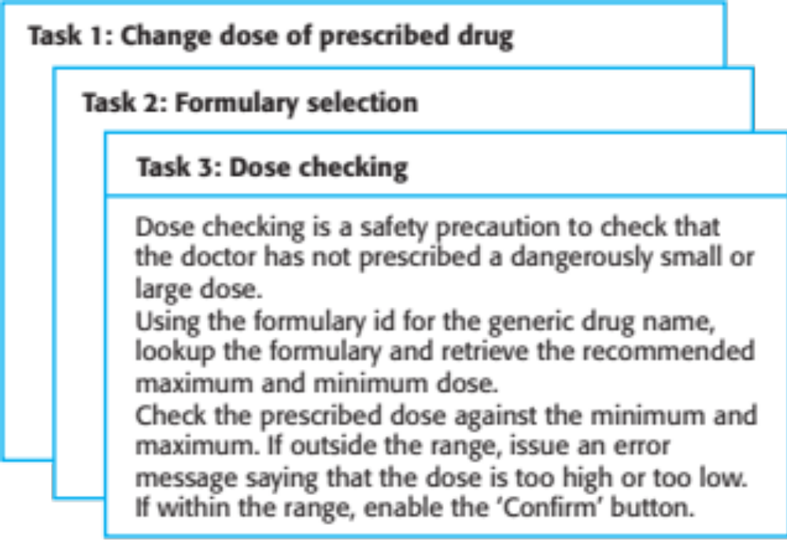
Examples of task cards for prescribing medication

Slide 11
Refactoring
Conventional wisdom in software engineering is to design for change. It is worth spending time and effort anticipating changes as this reduces costs later in the life cycle.
XP, however, maintains that this is not worthwhile as changes cannot be reliably anticipated.
Rather, it proposes constant code improvement (refactoring) to make changes easier when they have to be implemented.

Slide 12
Test-first development
Testing is central to XP and XP has developed an approach where the program is tested after every change has been made.
XP testing features:
  Test-first development.
  Incremental test development from scenarios.
  User involvement in test development and validation.
  Automated test harnesses are used to run all component tests each time that a new release is built.

Slide 14
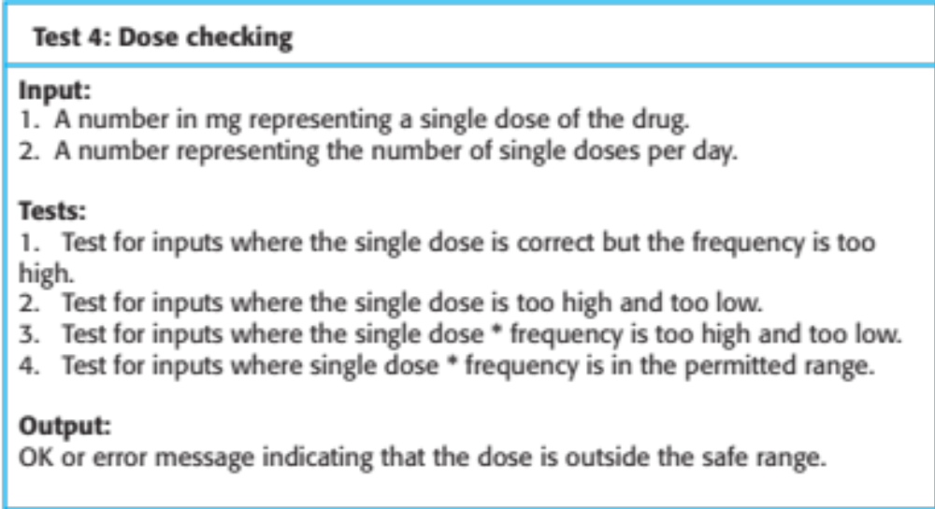
Test case description for dose checking

Slide 16
Problems with test-first development
Programmers prefer programming to testing and sometimes they take short cuts when writing tests. For example, they may write incomplete tests that do not check for all possible exceptions that may occur.
Some tests can be very difficult to write incrementally. For example, in a complex user interface, it is often difficult to write unit tests for the code that implements the ‘display logic’ and workflow between screens.
It difficult to judge the completeness of a set of tests. Although you may have a lot of system tests, your test set may not provide complete coverage.

Slide 18
Pair programming
Pair programming involves programmers working in pairs, developing code together.
This helps develop common ownership of code and spreads knowledge across the team.
It serves as an informal review process as each line of code is looked at by more than 1 person.
It encourages refactoring as the whole team can benefit from improving the system code.

Slide 19
Pair programming
In pair programming, programmers sit together at the same computer to develop the software.
Pairs are created dynamically so that all team members work with each other during the development process.
The sharing of knowledge that happens during pair programming is very important as it reduces the overall risks to a project when team members leave.
Pair programming is not necessarily inefficient and there is some evidence that suggests that a pair working together is more efficient than 2 programmers working separately.

Slide 20
Agile Project Management

Slide 21
Scrum
Scrum is an agile method that focuses on managing iterative development rather than specific agile practices.
There are three phases in Scrum.
  The initial phase is an outline planning phase where you establish the general objectives for the project and design the software architecture.
  This is followed by a series of sprint cycles, where each cycle develops an increment of the system.
  The project closure phase wraps up the project, completes required documentation such as system help frames and user manuals and assesses the lessons learned from the project.

Slide 22
Scrum terminology (a)
Scrum term | Definition
Development team | A self-organizing group of software developers, which should be no more than 7 people. They are responsible for developing the software and other essential project documents.
Potentially shippable product increment | The software increment that is delivered from a sprint. The idea is that this should be ‘potentially shippable’ which means that it is in a finished state and no further work, such as testing, is needed to incorporate it into the final product. In practice, this is not always achievable.
Product backlog | This is a list of ‘to do’ items which the Scrum team must tackle. They may be feature definitions for the software, software requirements, user stories or descriptions of supplementary tasks that are needed, such as architecture definition or user documentation.
Product owner | An individual (or possibly a small group) whose job is to identify product features or requirements, prioritize these for development and continuously review the product backlog to ensure that the project continues to meet critical business needs. The Product Owner can be a customer but might also be a product manager in a software company or other stakeholder representative.
30/10/2014

Slide 23
Scrum terminology (b)
Scrum term | Definition
Scrum | A daily meeting of the Scrum team that reviews progress and prioritizes work to be done that day. Ideally, this should be a short face-to-face meeting that includes the whole team.
ScrumMaster | The ScrumMaster is responsible for ensuring that the Scrum process is followed and guides the team in the effective use of Scrum. He or she is responsible for interfacing with the rest of the company and for ensuring that the Scrum team is not diverted by outside interference. The Scrum developers are adamant that the ScrumMaster should not be thought of as a project manager. Others, however, may not always find it easy to see the difference.
Sprint | A development iteration. Sprints are usually 2-4 weeks long.
Velocity | An estimate of how much product backlog effort that a team can cover in a single sprint. Understanding a team’s velocity helps them estimate what can be covered in a sprint and provides a basis for measuring improving performance.

Slide 24
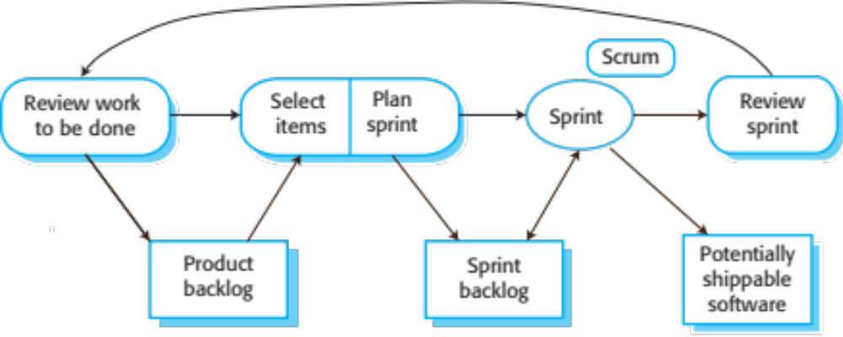
Scrum sprint cycle

Slide 25
The Scrum sprint cycle
Sprints are fixed length, normally 2–4 weeks.
The starting point for planning is the product backlog, which is the list of work to be done on the project.
The selection phase involves all of the project team who work with the customer to select the features and functionality from the product backlog to be developed during the sprint.

Slide 26
The Sprint cycle
Once these are agreed, the team organize themselves to develop the software.
During this stage the team is isolated from the customer and the organization, with all communications channelled through the so-called ‘Scrum master’.
The role of the Scrum master is to protect the development team from external distractions.
At the end of the sprint, the work done is reviewed and presented to stakeholders. The next sprint cycle then begins.

Slide 27
Teamwork in Scrum
The ‘Scrum master’ is a facilitator who arranges daily meetings, tracks the backlog of work to be done, records decisions, measures progress against the backlog and communicates with customers and management outside of the team.
The whole team attends short daily meetings (Scrums) where all team members share information, describe their progress since the last meeting, problems that have arisen and what is planned for the following day.
  This means that everyone on the team knows what is going on and, if problems arise, can re-plan short-term work to cope with them.

Slide 28
Scrum benefits
The product is broken down into a set of manageable and understandable chunks.
Unstable requirements do not hold up progress.
The whole team have visibility of everything and consequently team communication is improved.
Customers see on-time delivery of increments and gain feedback on how the product works.
Trust between customers and developers is established and a positive culture is created in which everyone expects the project to succeed.

